Slide 1

SMART INVENTORY MANAGEMENT
Leveraging Big Data - AWS S3, Athena, Sagemaker and QuickSight
TEAM 12

Slide 2
Motivation
Target Audience
01
02
Table Of Contents
Business Impact
Process Flow
03
04
05
Technologies
06
Our Use case
Why inventory management analysis?
Who can benefit most from our project?
What is the business value of our project?
What is the general procedure of smart inventory management?
Why AWS? Why is it superior for smart inventory management involving big data?
Description of dataset;
Results:
Feature engineering,
modeling, visualisation

Slide 3
OUR MOTIVATION
OUR MOTIVATION
The inability in inventory management leads to:
poor service quality,
unsatisfied customers,
excess/inadequate amount of stock
Cloud computing platforms such as AWS makes it possible to analyze tons of data collected from daily inventory management.

Slide 4
OUR MOTIVATION(cont’d)
OUR MOTIVATION
In the era of big data, we are able to build predictive models to make:
seasonal predictions using historical data (e.g. retail store)
real-time inventory forecast for fast moving products such as perishable products (e.g. bakery) or e-commerce using streaming data

Slide 5
TARGET AUDIENCE
TARGET AUDIENCE
Big-data related inventory management has wide applications across industries.
Examples:
Physical Retail stores involving:
Food and beverage
Apparel ...
E-Commerce platforms:
Amazon
Best Buy ...

Slide 6
BUSINESS IMPACT
BUSINESS IMPACT
Improved operational efficiency
Historically, employees at retail stores spent hours to manually check the shelves, and make subjective decisions on product replenishment.
Now, significant decrease in out-of-stock events, spend half an hour to look into the suggestions offered by predictive models.

Slide 7
BUSINESS IMPACT (cont’d)
BUSINESS IMPACT
2. cost-saving for retail stores
customer retention
-> reduce the possibility of product shortage
-> improved customer satisfaction
-> reduce cost in customer retention
inventory management
-> avoid excess supply to reduce storage cost
-> avoid product waste

Slide 8
PAST
Challenges faced by traditional legacy systems
Inability to handle high data volumes
Costly storage
High Latency due to low computational power
Poor Integrability with various systems/data sources
PAST
Notes:
High data volumes present the biggest challenge to conventional IT structures (legacy systems/ERPs) since on-premise solutions typically do not have the capacity to manage large datasets.

Slide 9
NOW
How Big Data solves the challenges?
The value of big data is how quickly patterns and trends can be identified
Rapid analysis of vast amounts of information at substantially faster speeds.
Reduced Costs By Migrating to the Cloud
Seamlessly integrated into existing systems at low costs.
NOW
Notes:
Big data allows for rapid analysis of vast amounts of information at substantially faster speeds.
Big data exists in real-time and involves prompt access to data, alerts and inventory management and control metrics through cloud computing systems. The value of big data is how quickly patterns and trends can be identified.
access to real-time customer demand pattern data
Reduced Costs By Migrating to the Cloud
Seamlessly integrated into existing systems at low costs.
Big data collects information from a variety of sources that extend to external sources, such as scanners, CRM, sales systems, social media, web-based data, enterprise resource planning tools, and accounting systems, and puts them together into a high-velocity and real-time overview of operations. The speed and size of this type of data would overwhelm conventional processing and storage systems

Slide 10
PROCESS FLOW
PROCESS FLOW
Glue
Stage 2 Athena: use SQL queries to perform basic data aggregations
Stage 1 S3: store inventory-related data
Stage 3 QuickSight: exploratory data visualization using the tables created in Athena
Stage 4 Sagemaker: build predictive models to predict sales and demand
Stage 5
QuickSight: visualize predictive results, and offer suggestions on inventory optimization
Notes:
benefit of

Slide 11
TECHNOLOGIES
TECHNOLOGIES
S3: object storage platform used to store and retrieve any amount of data from anywhere
Glue: fully managed extract, transform, and load (ETL) service that makes it easy to prepare and load data for analytics
Sagemaker: machine learning services that enable us to deploy predictive models quickly.
Athena: interactive query service that makes it easy to analyze data stored in S3 using SQL
QuickSight: a fast, cloud-powered business intelligence service that makes it easier to create interactive dashboard that include ML insights.
Notes:
https://aws.amazon.com/s3/
https://aws.amazon.com/athena/
comparison: compare aws technologies with other technologies, and why ours are better
ERP
SAP
S3
Athena
Sagemaker
QuickSight
description and comparison

Slide 12
WHY AWS ?
Comparison with other technologies

Slide 13
OUR USE CASE
OUR USE CASE
Stage 1 - Dataset
Stage 2 - Feature Engineering & Modeling
Stage 3 - Visualization

Slide 14

DATASET
DATASET
Historical sales transactions for bakery goods (BIMBO) in Mexico
Training data : 7 weeks
Testing data : 2 weeks
Data fields:
week number
sales channel
sales depot (id, location - town, state)
client (id, client name)
product (id, product name)

Slide 15
FEATURE ENGINEERING & MODELLING
FEATURE ENGINEERING & MODELLING
Feature processing with Scikit-Learn on Sagemaker notebook
Prediction using estimators in Sagemaker
End to end deployment using Amazon Sagemaker Inference pipelines

Slide 16
VISUALIZATIONS
VISUALIZATIONS

Slide 17
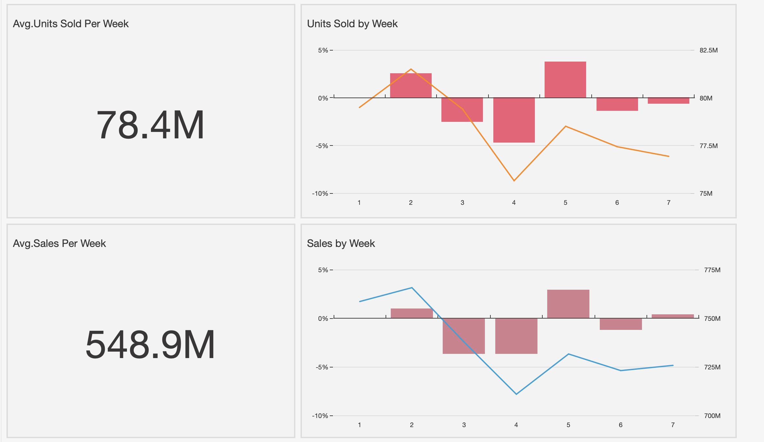
Business Performance Overview

Slide 18
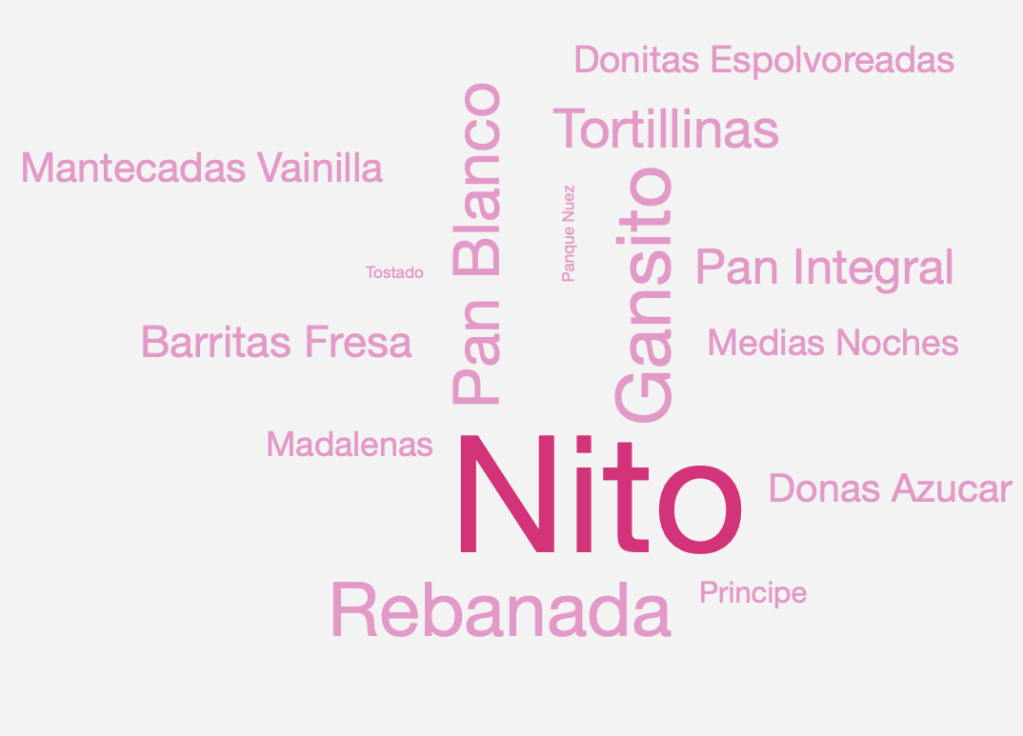
Top Sellers

Slide 19
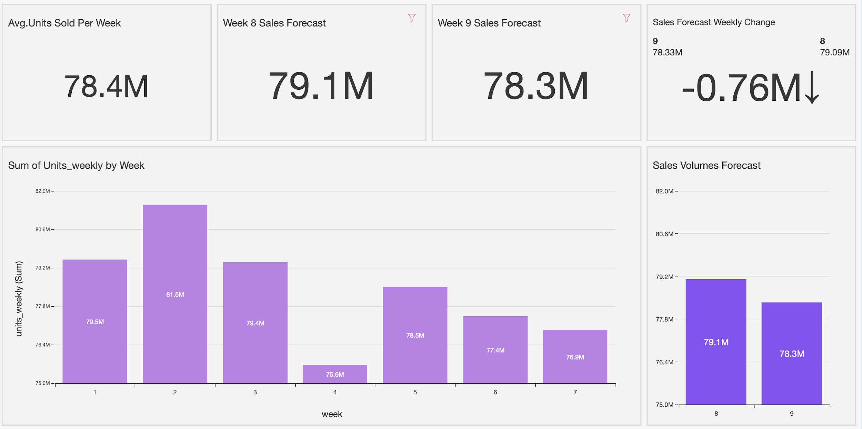
Sales Forecasting for the Upcoming Weeks

Slide 20
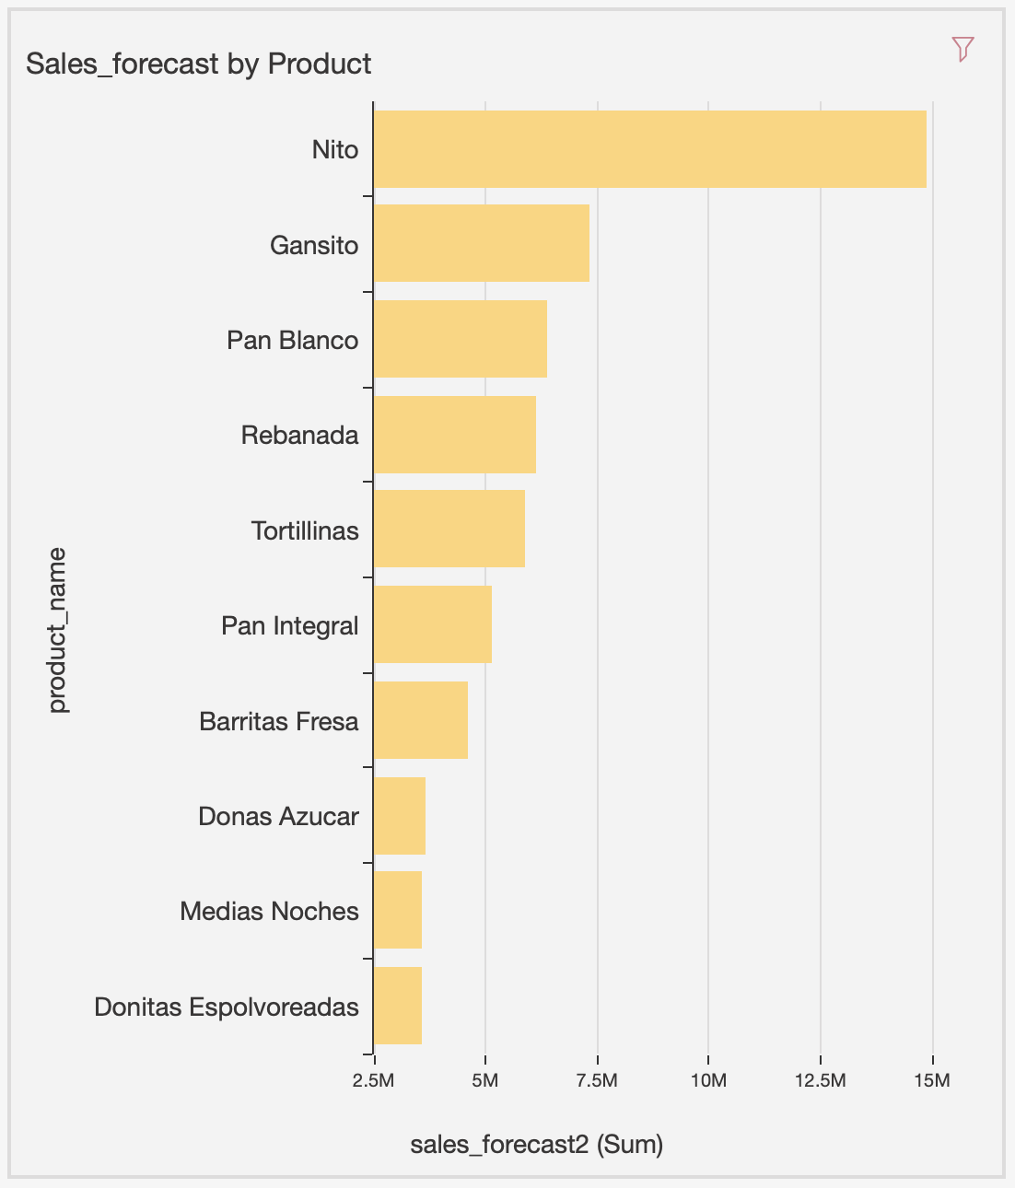
Better Arrange Products Based on Forecast

Slide 21
FUTURE DIRECTIONS
FUTURE DIRECTIONS

Slide 22

THANKS
TEAM 12
Deepak Vohra | vohra016@umn.edu
Rishab Prashanth | prash011@umn.edu
Sidharth Manne | manne098@umn.edu
Xue Ni | ni000054@umn.edu
Xuan Ji | ji000084@umn.edu
Minya Na | namin003@umn.edu

